Slide 1

BLAZING RACER TEAM 3D
Phase 3 Presentation

Slide 2
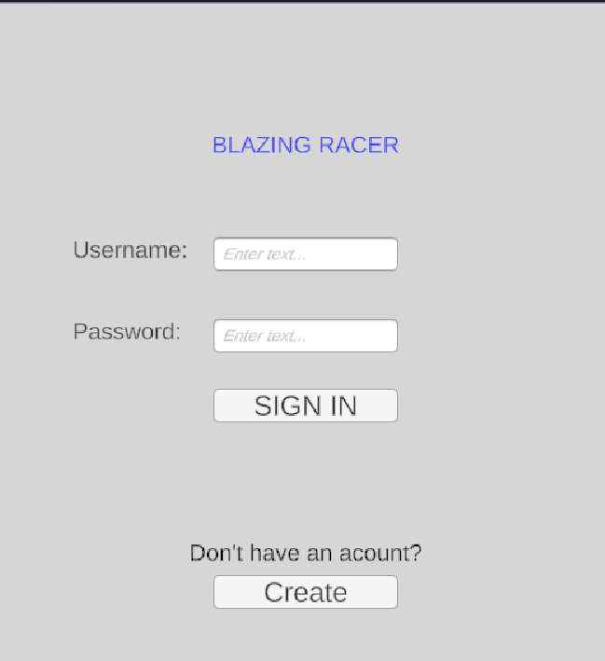
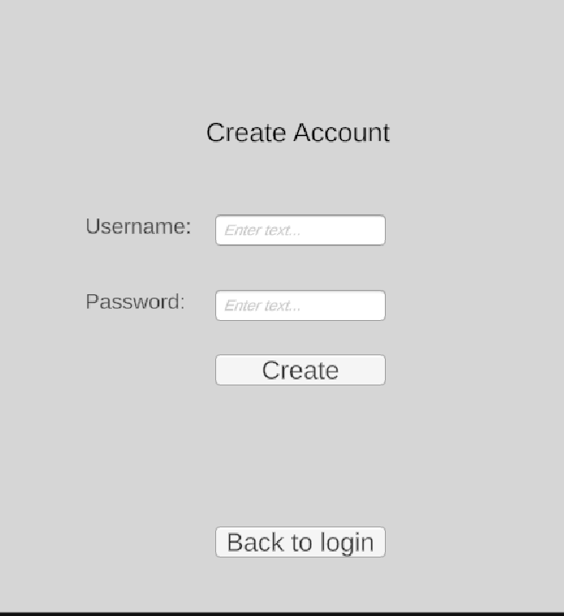
Improved Login System
SIGN IN
CREATE ACCOUNT
OVERVIEW
User authentication system (login + register)
Data stored in MySQL users table
Password + username validation via Node.js server
Unity sends login request using HTTP
Notes:
“We implemented a login system where users can create an account and sign in. The data is stored in a MySQL database in the users table. Unity sends the login request to a Node.js server, which checks the database and returns if the login is successful or not.”

Slide 3
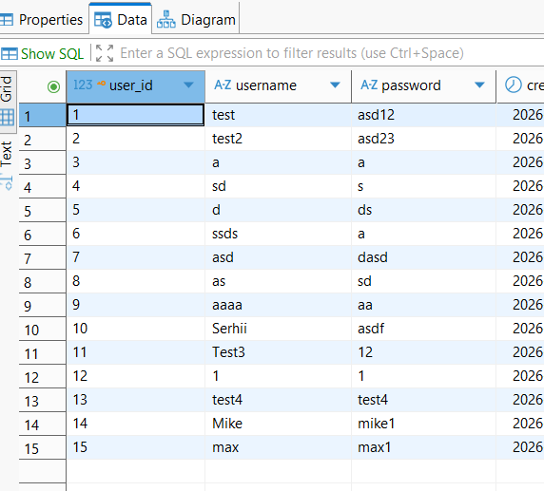
Server & Database
Backend built with Node.js + Express
Connected to MySQL database (blazing_racer)
Stores race results (user_id, lap_time, date)
API endpoints for login and saving data
Notes:
“We used a Node.js server with Express to handle communication between Unity and the database. The server connects to a MySQL database where we store users and race results. Unity sends requests to the server, and the server saves or retrieves data from the database using API endpoints.”

Slide 4
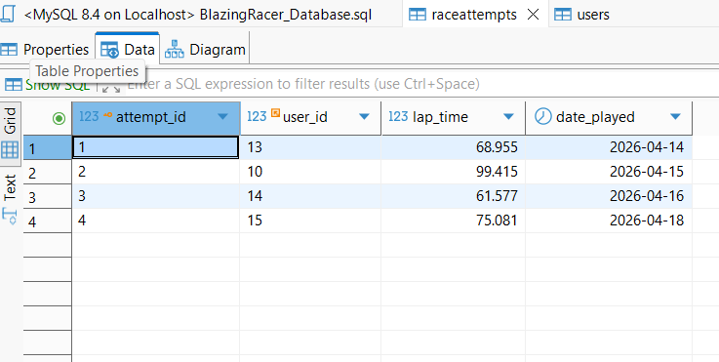
Race Data System
Timer tracks race completion time
Results saved after finishing race
Linked to user via user_id
Data used for leaderboard
Notes:
“After the race finishes, the timer value is sent to the server and saved in the RaceAttempts table. Each result is linked to a user ID, so we know who achieved each time. This data is then used for the leaderboard system.”

Slide 5
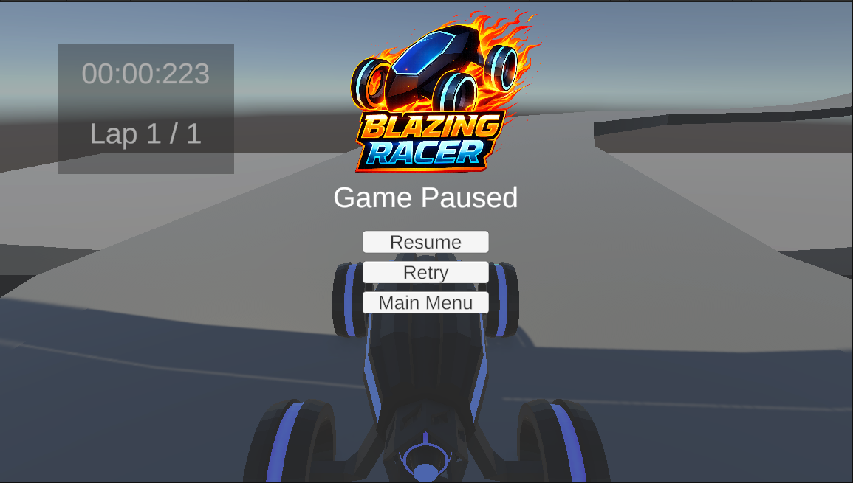
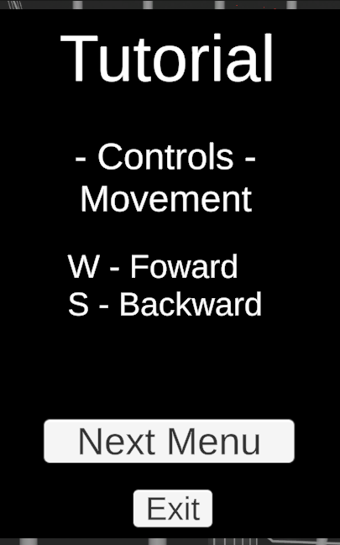
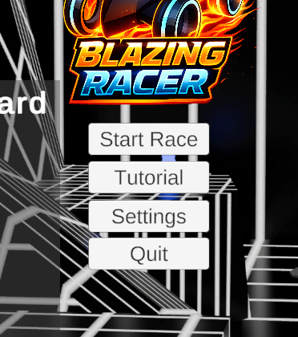
Menu Progress
Progress was steady with several new features added to the menus of the game. First one was button functions, most were ‘A to B’ which a few were a bit unique. A pause the that stop time in the game with the addition of a retry button. And a simple tutorial that tells you the controls and your goal.
Notes:
Progress for the front was steady with many of the important features being implement. The first one, button functions, most opened scenes but there were a few unique ones that opened menus. The second was a pause menu during game play, it simple in the scene it only functions were stopping time, a retry if needed, and the ability to return to the main menu. The third most important was a tutorial, it overall look is simple but it does it job of telling you the controls and the goal of the game.

Slide 6
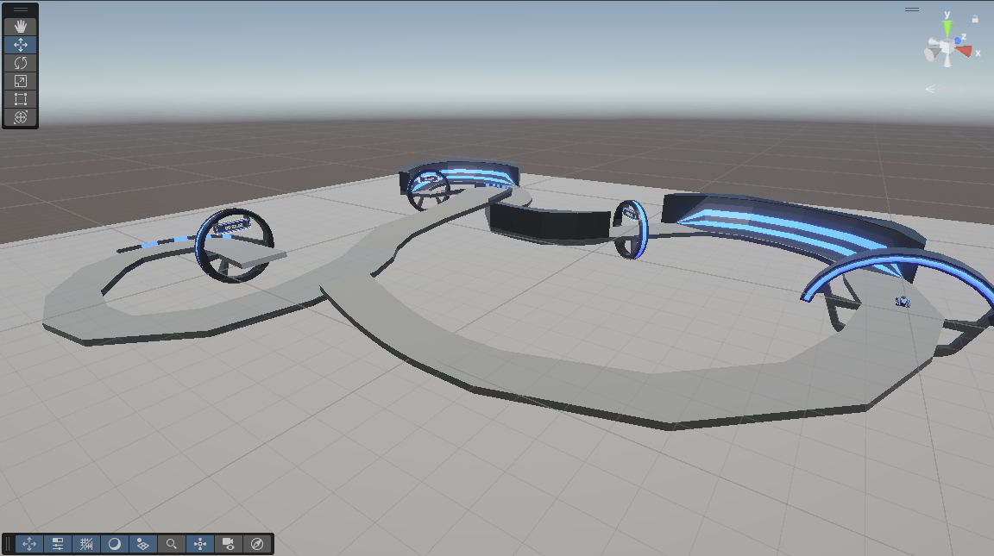
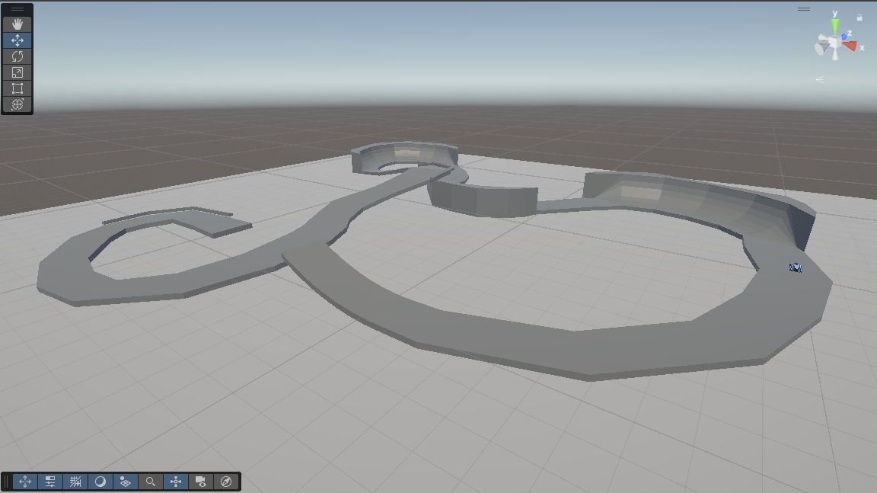
3D Model Progress
During the first week of Phase 4 the track model was finalized functionally so our team could test game functions. It was left in that state till the last week of the phase, which once the game functions were finalized. Which the track and game function objects were converted into the Tron theme we are doing.
Notes:
During the first week of Phase 4 the track model was finalized functionally so our team could test game functions. It was left in that state till the last week of the phase, which once the game functions were finalized. Which the track model and game function objects were converted into the Tron theme we are doing. I did have plans on add more cosmetic models like one that would look like a kill barrier but do to time constraints it was shelfed.

Slide 7
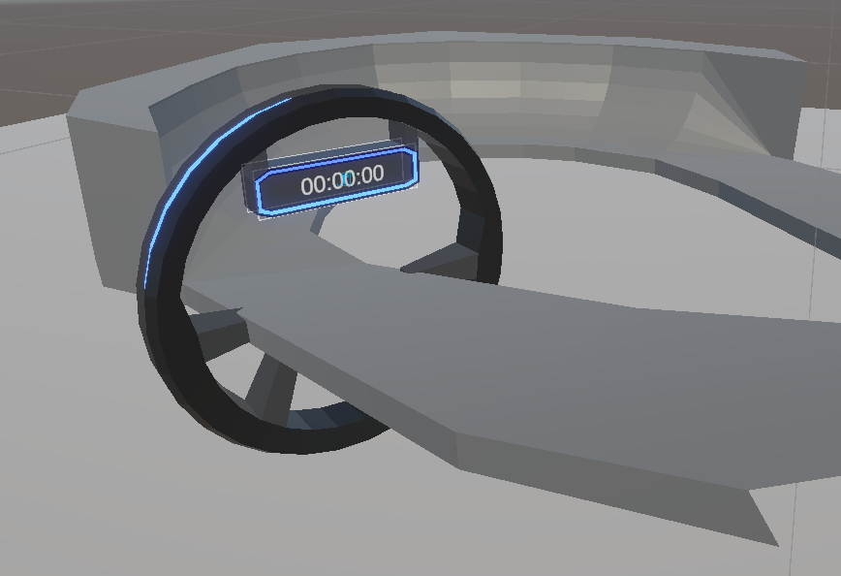
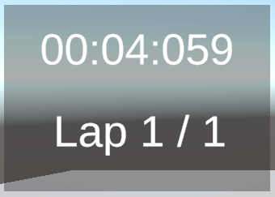
Gameplay Mechanics Progress
Throughout phase 3, more and more gameplay mechanics were introduced. Mechanics were introduced in this order:
UI Timer
Checkpoints + a Finish Line
Death Barrier below the track, respawn at last crossed checkpoint (or finish line if none crossed)
Have timer properly stop when crossing finish + expose final time as a variable.
Manual Respawn Button (Currently controller only)
UI Lap Counter
NOTE: These images are from an older build and may not fully reflect the final product.

Slide 8
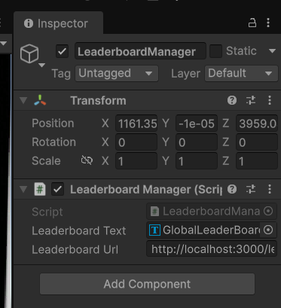
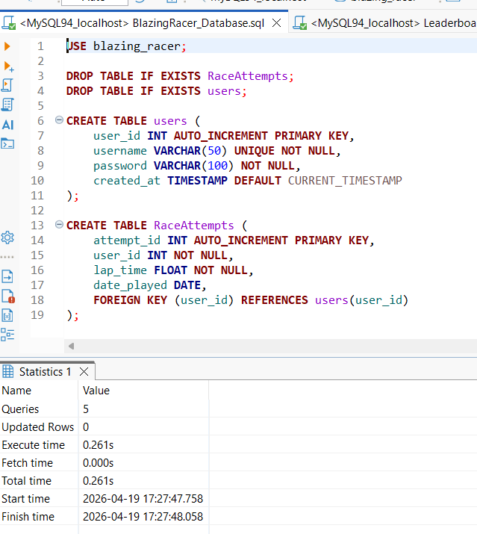
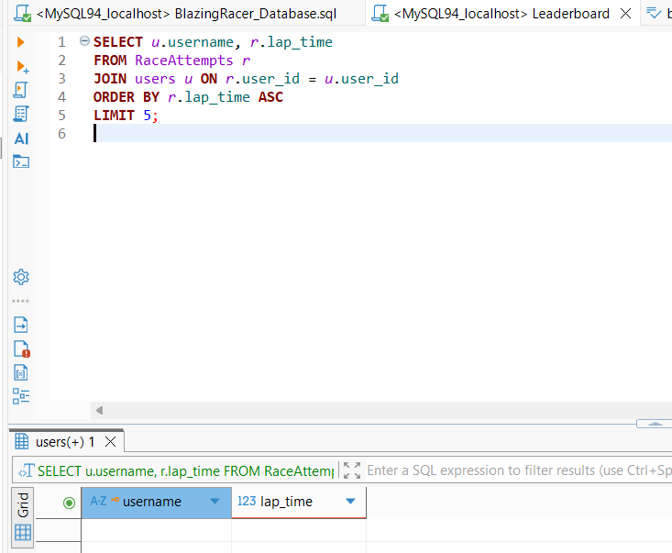
Picture of leaderboard
The leaderboard is used for tracking the times of the top 5 times that are posted after finishing the race.
What we used was SQL database
And unity scripts and manager.

Slide 9
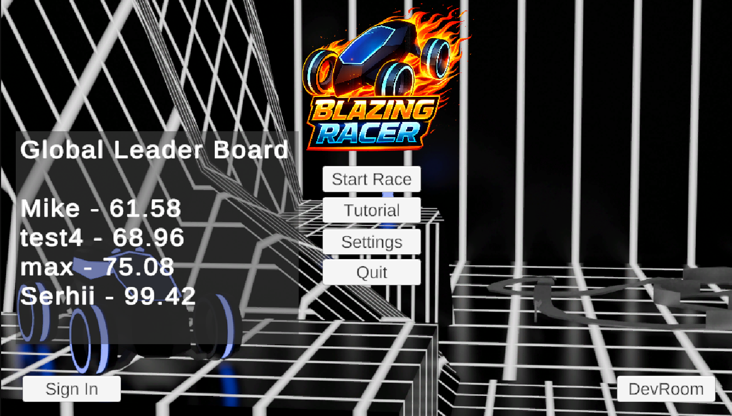
The leaderboard
So, this is the leaderboard for the game.
The way that it works is using the server called node server.js
That is how it makes the Unity and SQL database work together.

Slide 10
Live Demo
Narrated by Kent
Shown by Serhii
Live Demo Section

Slide 11

THANK YOU
for listening!
Any Questions?

